Slide 1
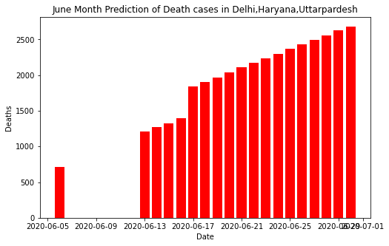
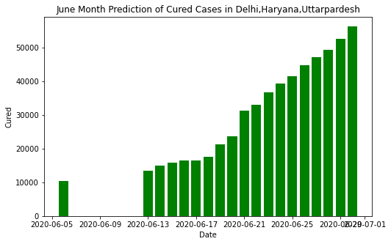
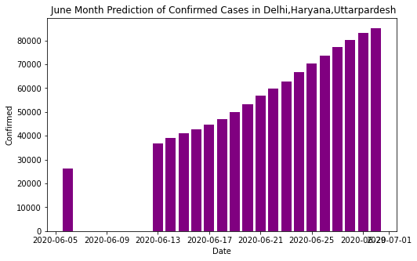
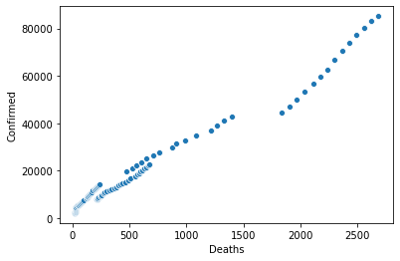
A Brief Analysis of Covid Confirmed Cases, Death Cases, Cured Cases in Delhi, Haryana and Uttar Pradesh from 1 June to 30 June
June month analysis of no of deaths, confirmed cases in Delhi, Haryana, Uttar Pradesh

